Slide 1
Kid’s Wear

Slide 2
GROUP MEMBERS
Member1 Name:- Bhojwani Deepak Rajeshkumar
Enrollment No:- 225160694006
Member2 Name:- Zakhariya Abhishek Pravinbhai
Enrollment No:- 225160694039

Slide 3
PROJECT PROFILE
Project Title:-
Kid’s Wear
Team Size And Role:-
Team Size:- Two.
Role:-
Requirement Gathering:- Abhishek, Deepak
Analysis:- Abhishek, Deepak
Logical Design:- Abhishek, Deepak

Slide 4
AIM OF PROJECT
The aim of our project is to manage to all the details of shopping, internet, customers. The project is totally built at administrator is guaranteed the access.
The purpose of the project is to built an application program to reduce the manual work for managing the shopping, internet, products. It tracks all the details about the bills and customers.

Slide 5
SCOPE OF PROJECT
This is web based application.
This application use to order online clothes for kids.
Admin can view registered users.
Admin add and remove a category from the site.
Admin add, update and remove a product from the site.
Admin can manage the received orders from the customers.
User can see full products with description.
User can add products into cart and remove product from the cart.
User can place orders and see their orders from the site.
User can Download Invoice Pdf after Placing Order.

Slide 6
TOOLS AND TECHNOLOGY
Software Suggested/Required:-
Operating System :- Windows 10
Front End :- HTML, CSS, JAVASCRIPT
Back End :- ASP.net
Database :- SQL server 2012
Tools :- Visual Studio 2012

Slide 7
REGISTRATION

Slide 8
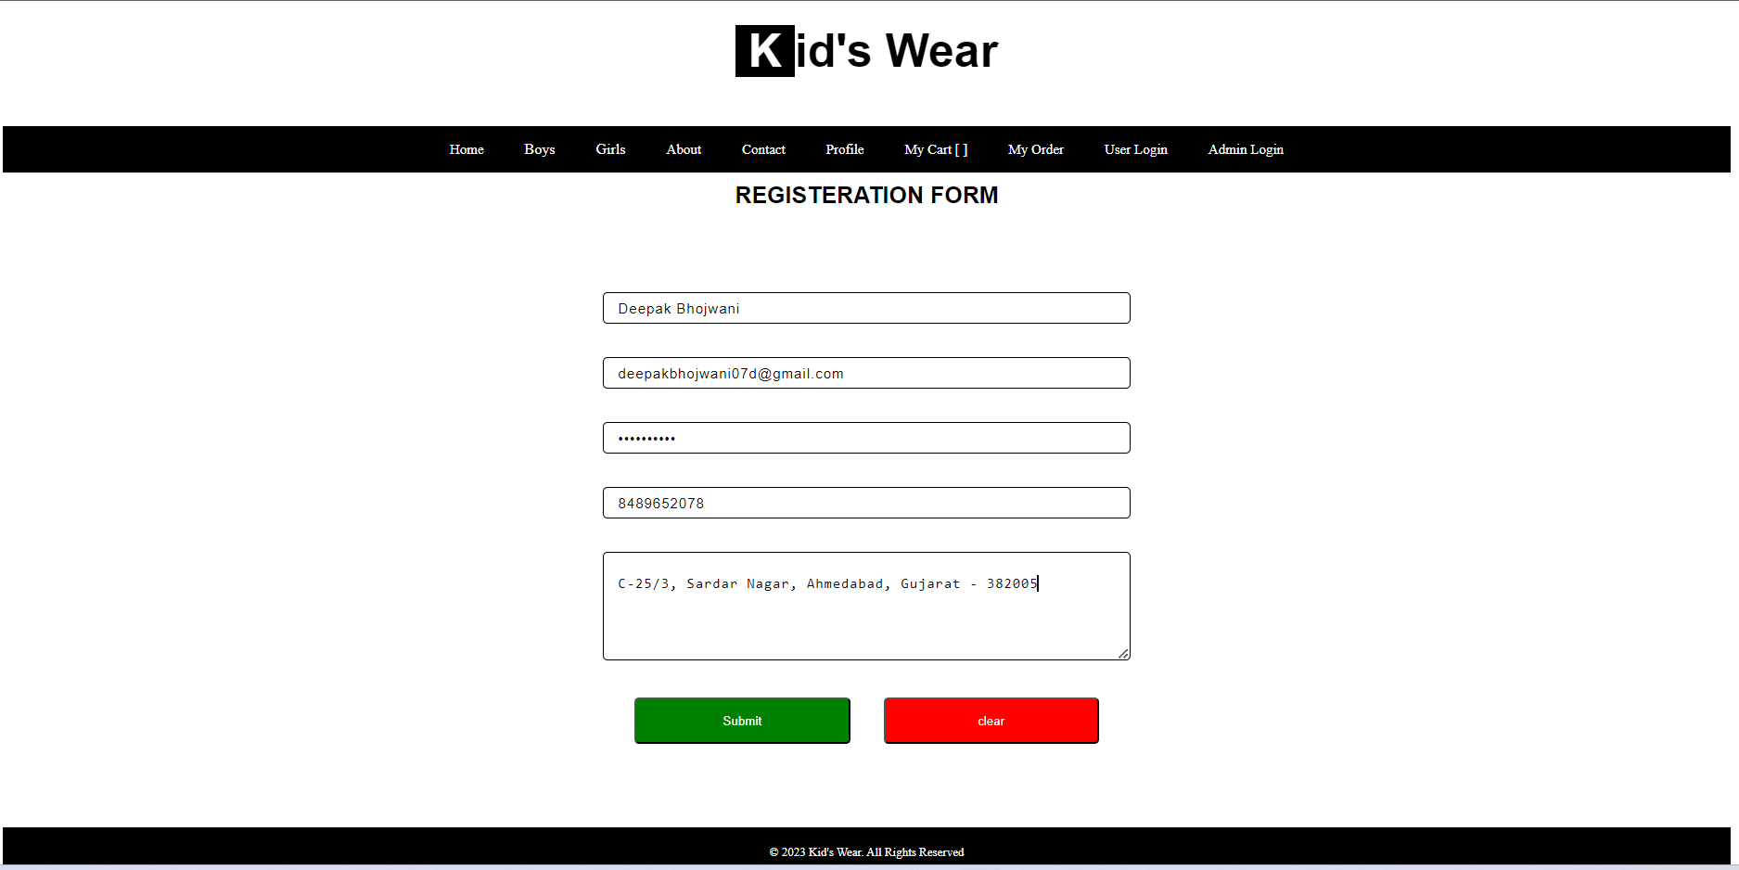

Slide 9
USER - LOGIN

Slide 10
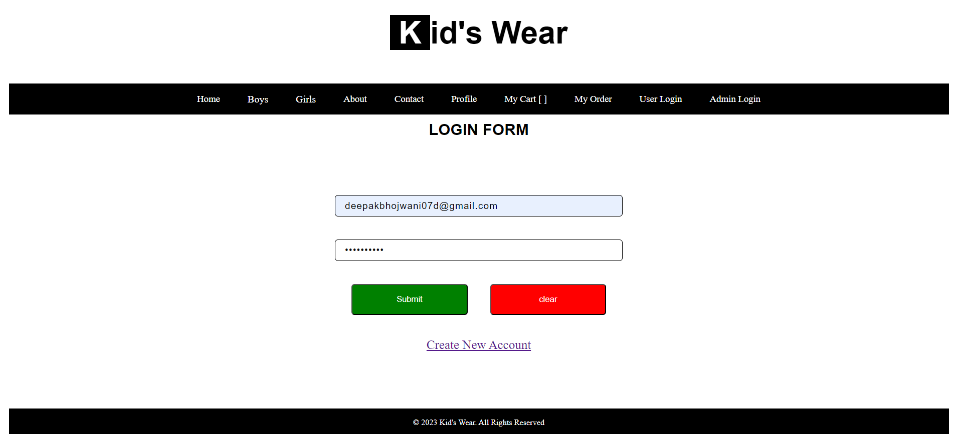

Slide 11
HOMEPAGE

Slide 12
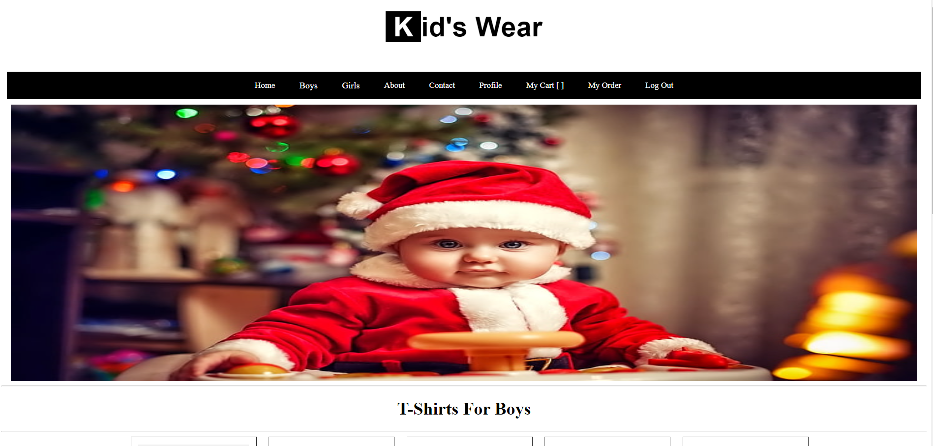

Slide 13
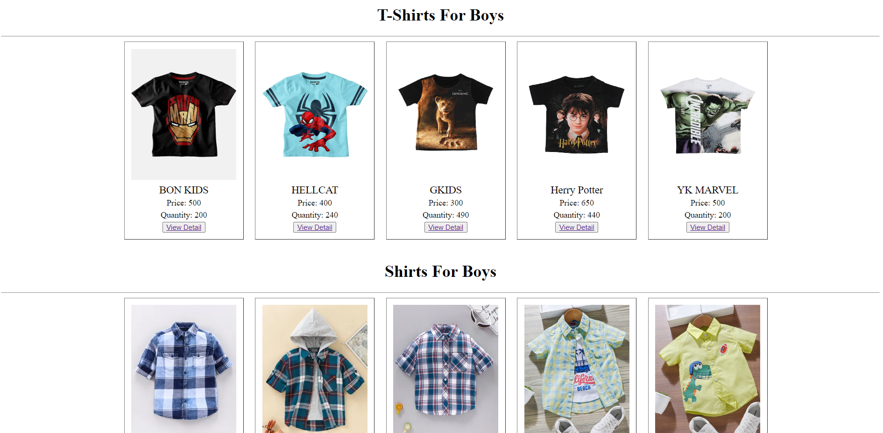

Slide 14
CATEGORY

Slide 15
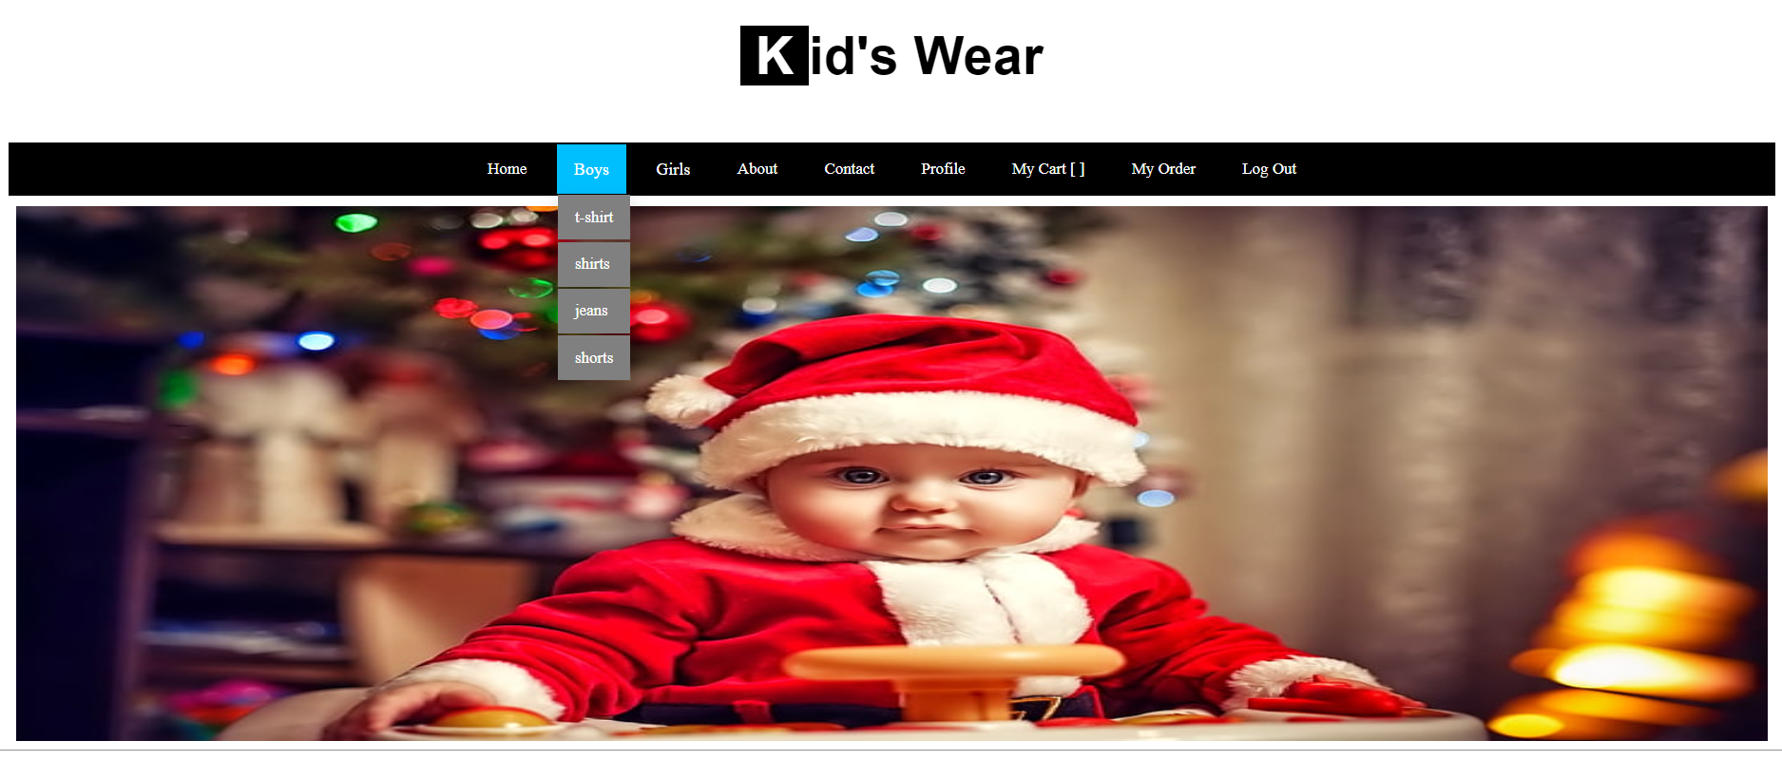

Slide 16
PRODUCTS

Slide 17
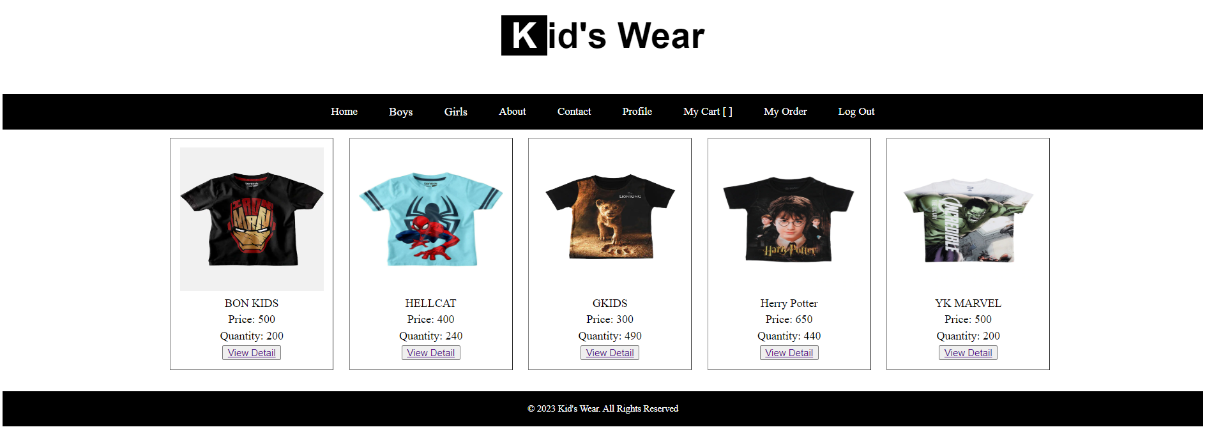

Slide 18
ADD TO CART

Slide 19
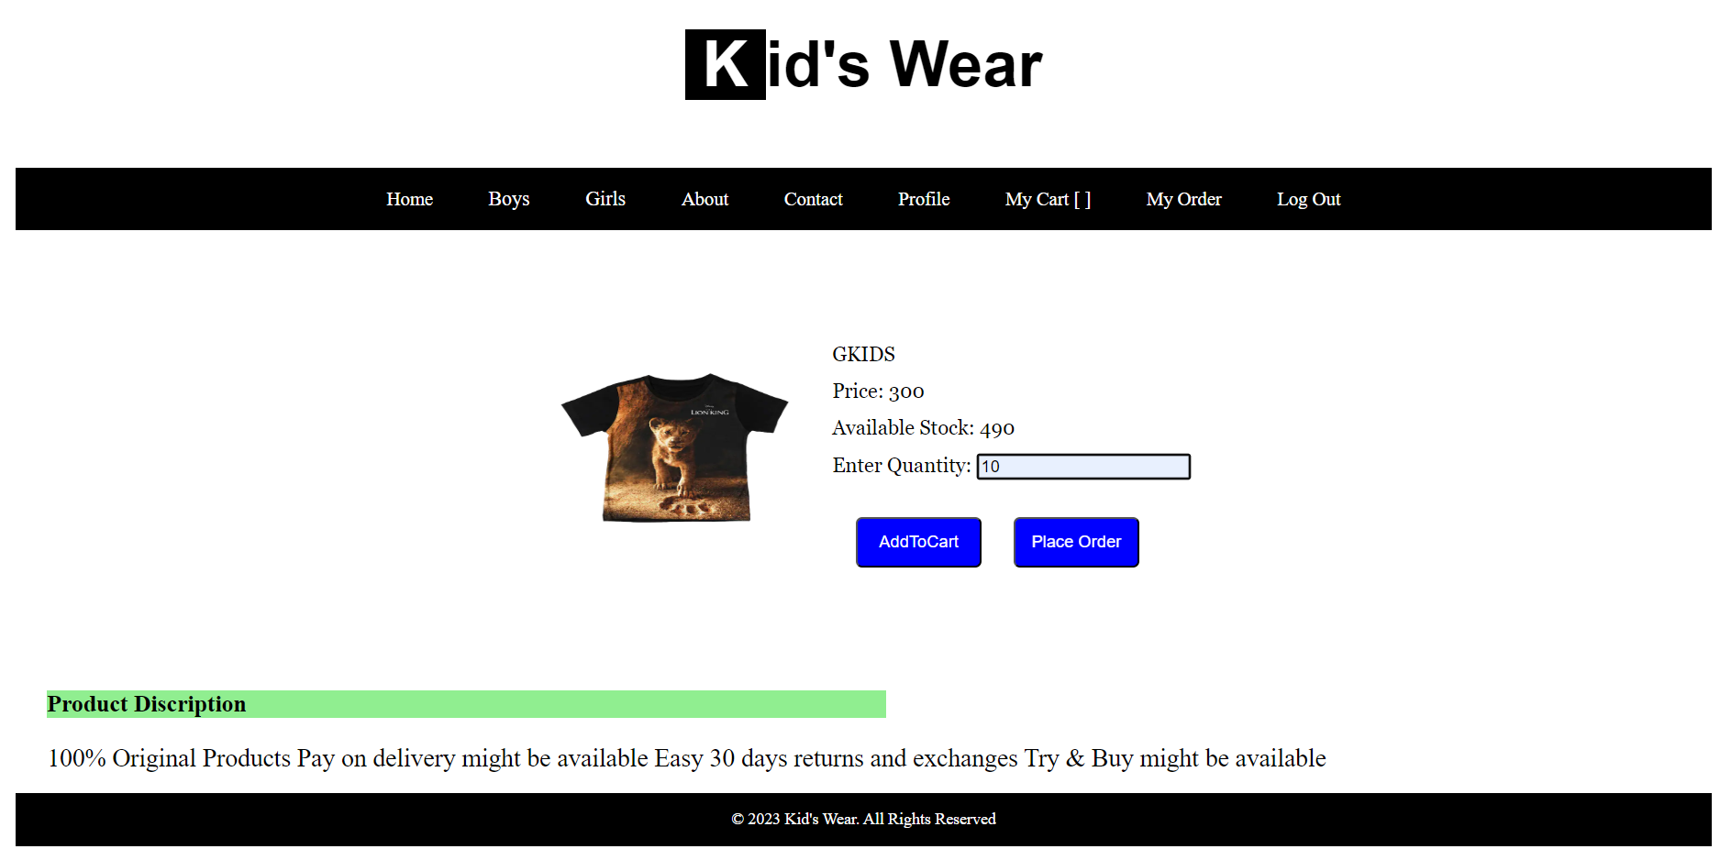

Slide 20
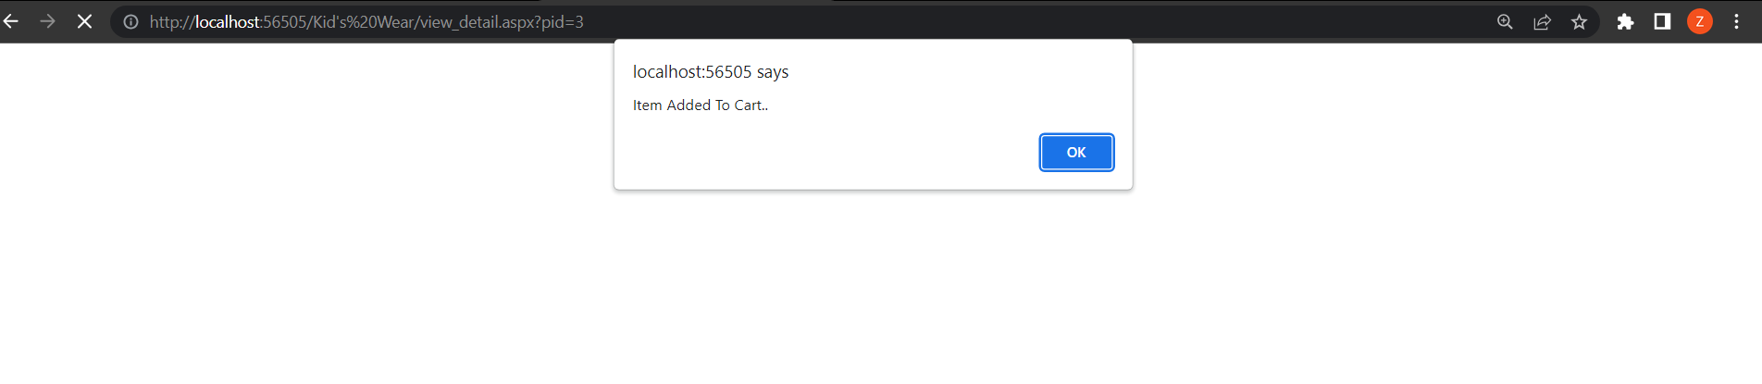

Slide 21
MY CART (VIEW CART)

Slide 22
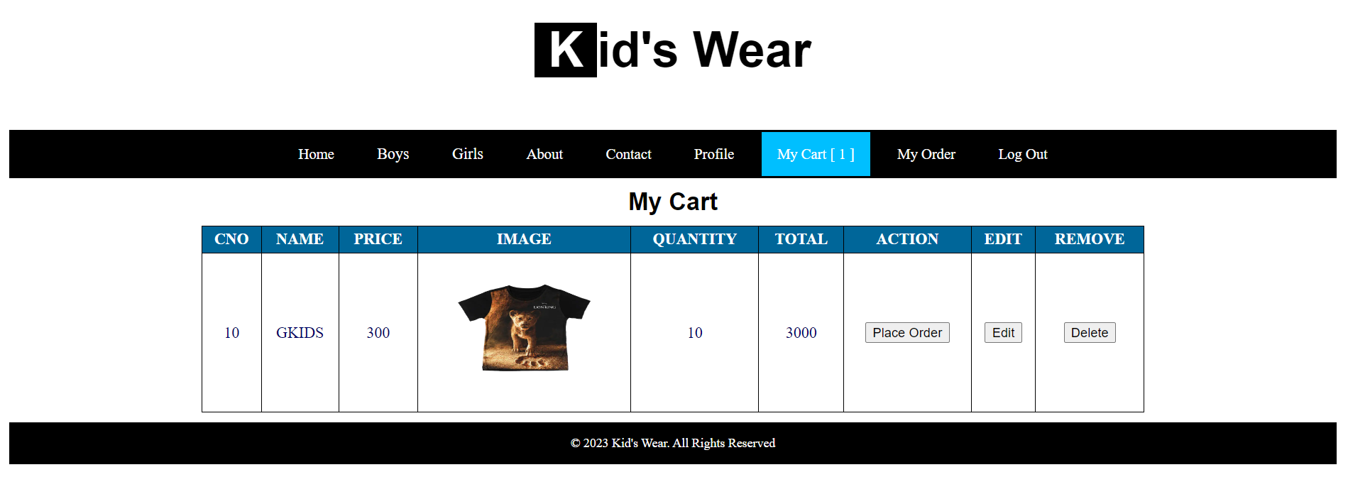

Slide 23
PLACE ORDER

Slide 24
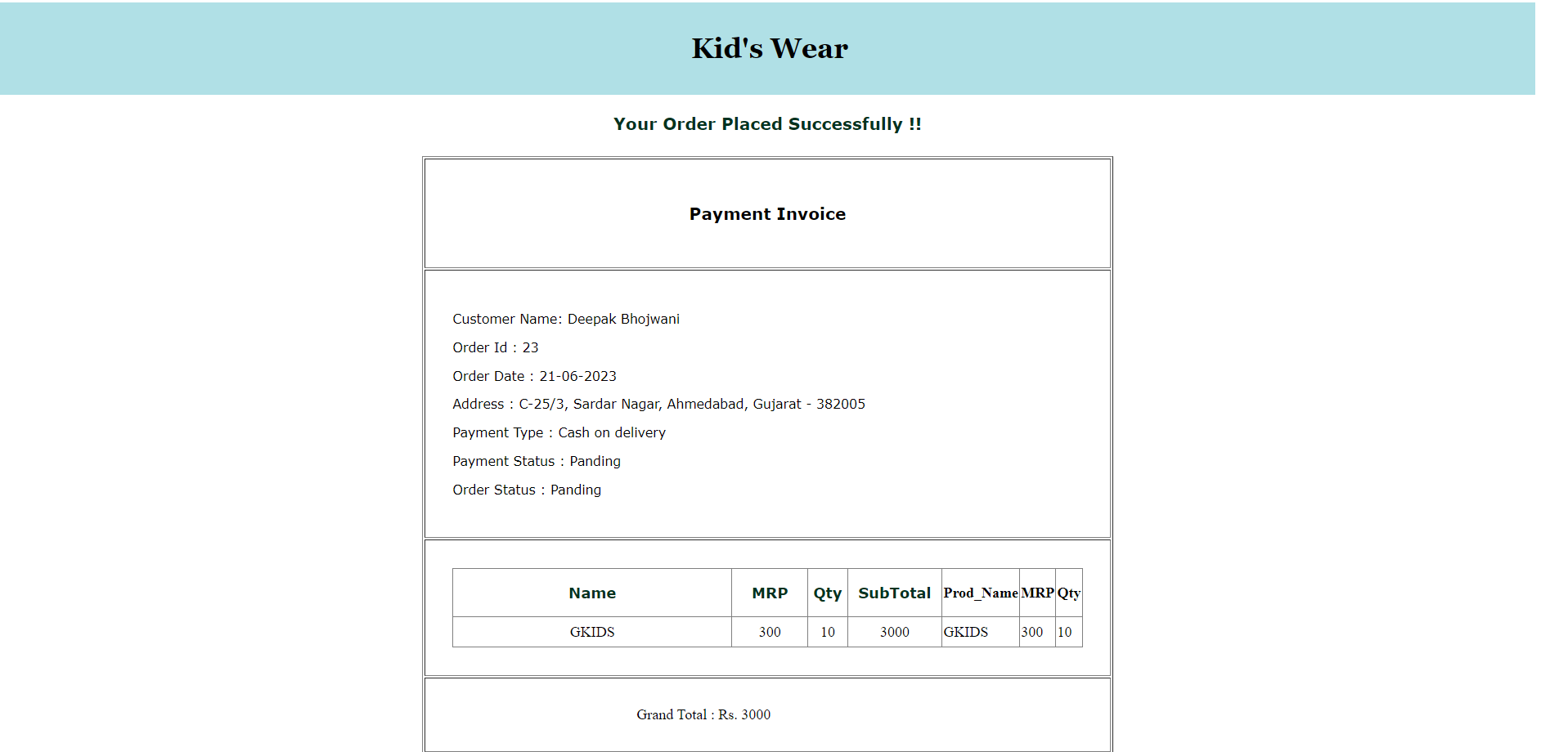

Slide 25
MY ORDER (VIEW ORDER)

Slide 26
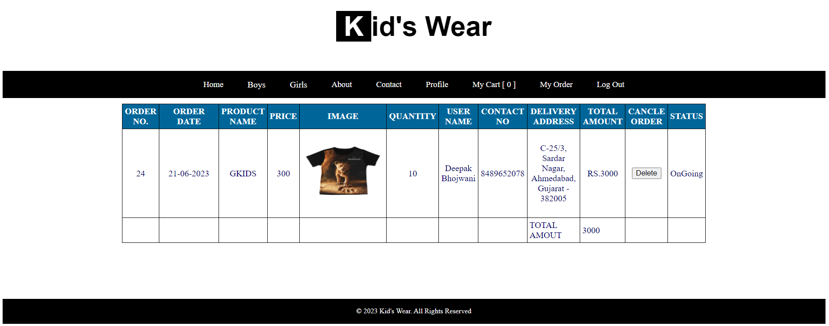

Slide 27
ABOUT US

Slide 28
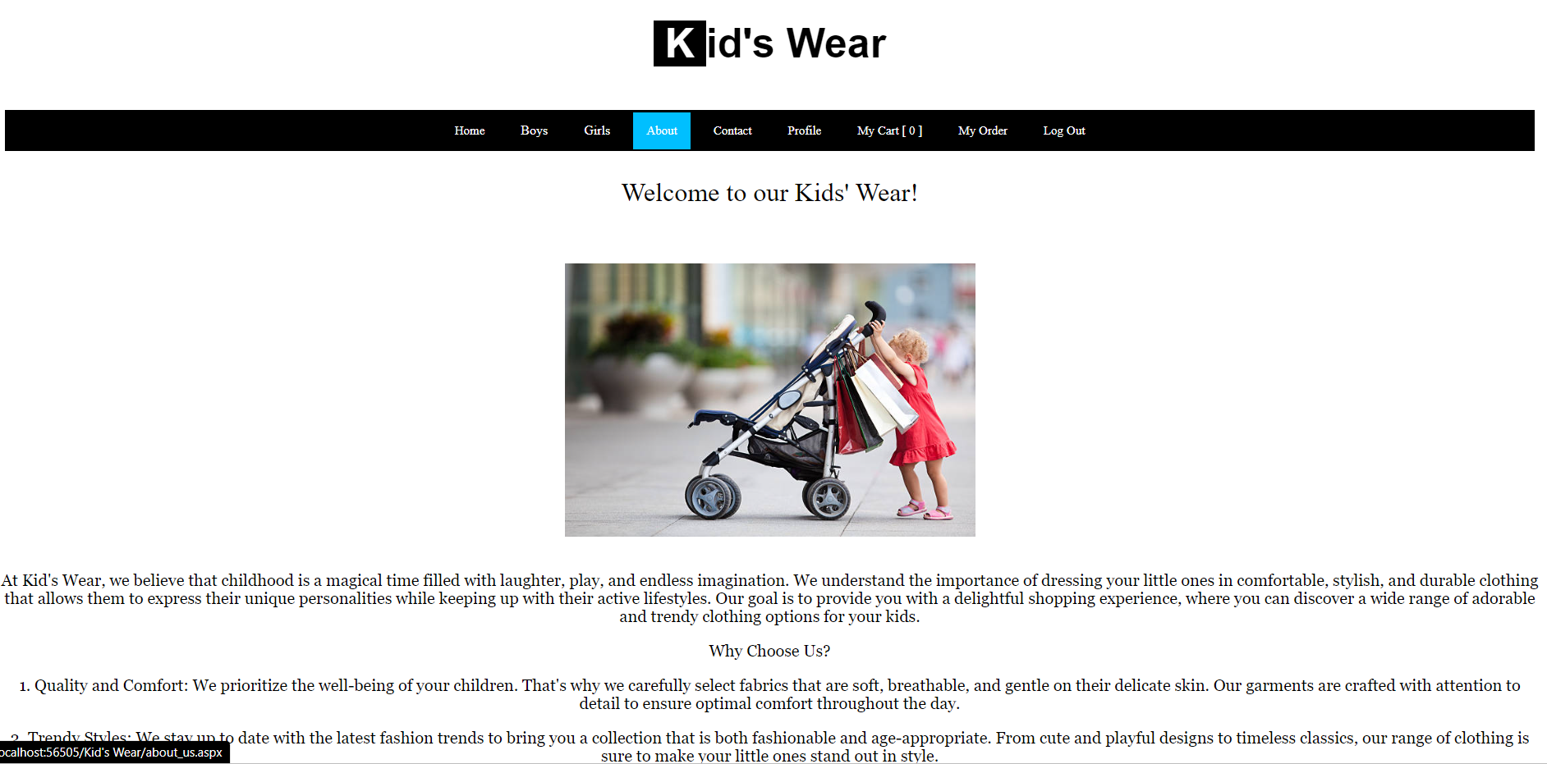

Slide 29
CONTACT US

Slide 30
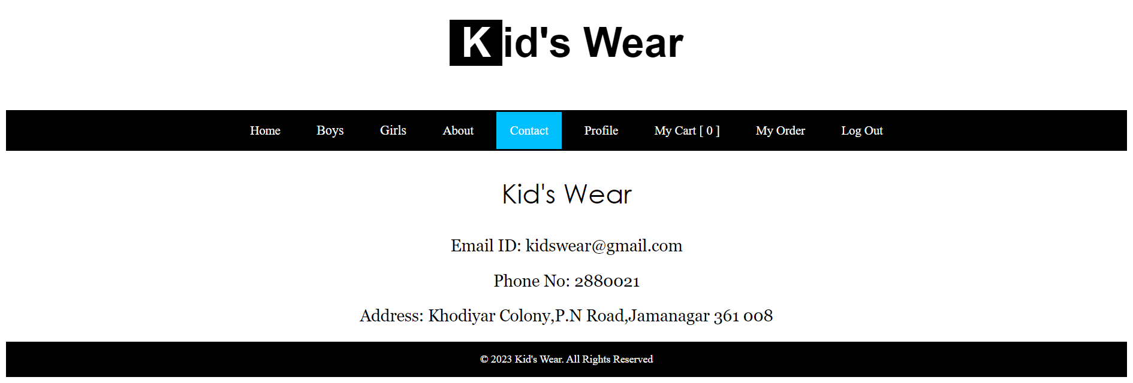

Slide 31
PROFILE

Slide 32
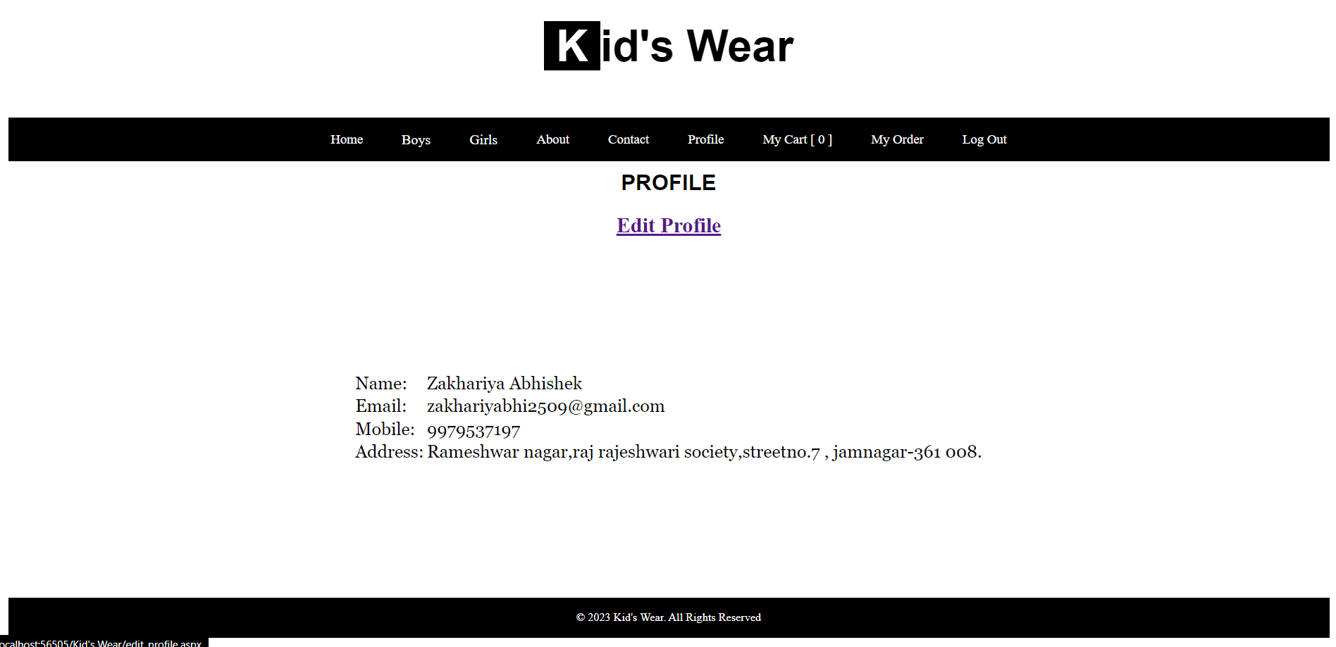

Slide 33
EDIT PROFILE

Slide 34
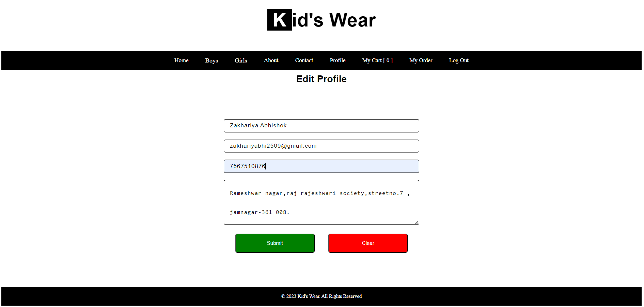

Slide 35
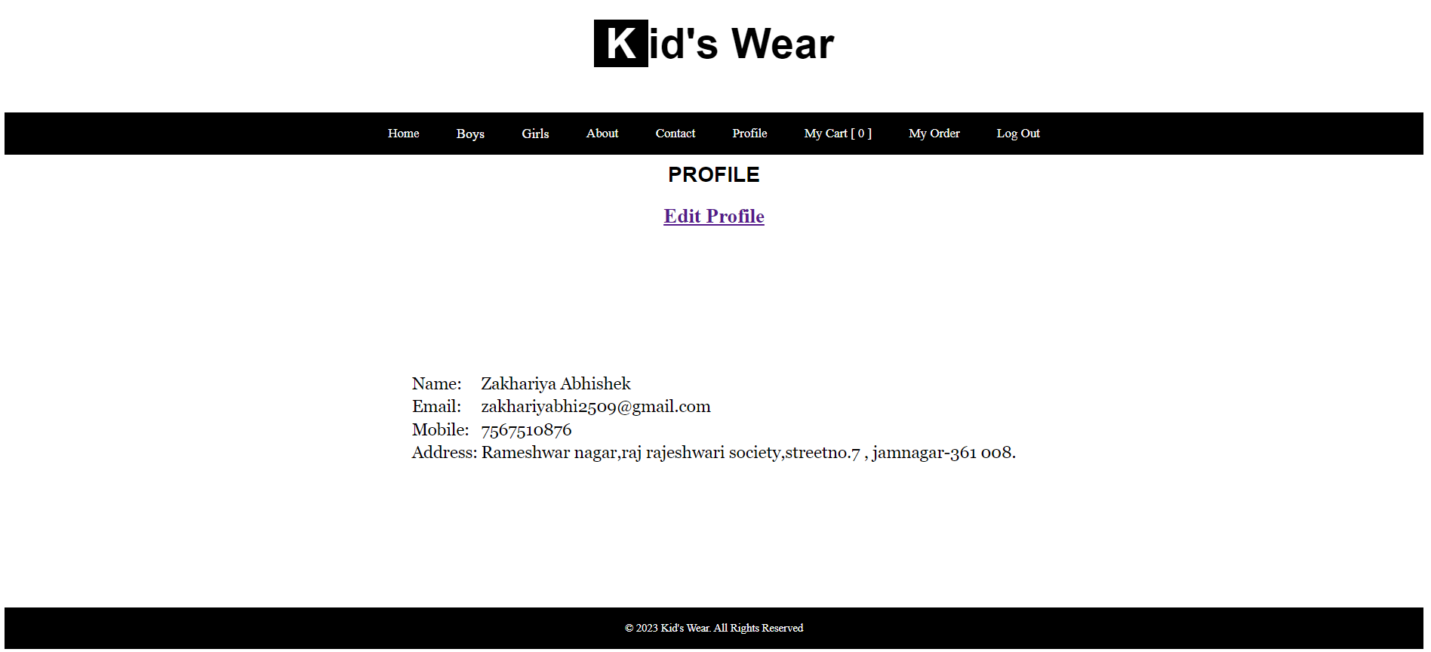

Slide 36
ADMIN - LOGIN

Slide 37
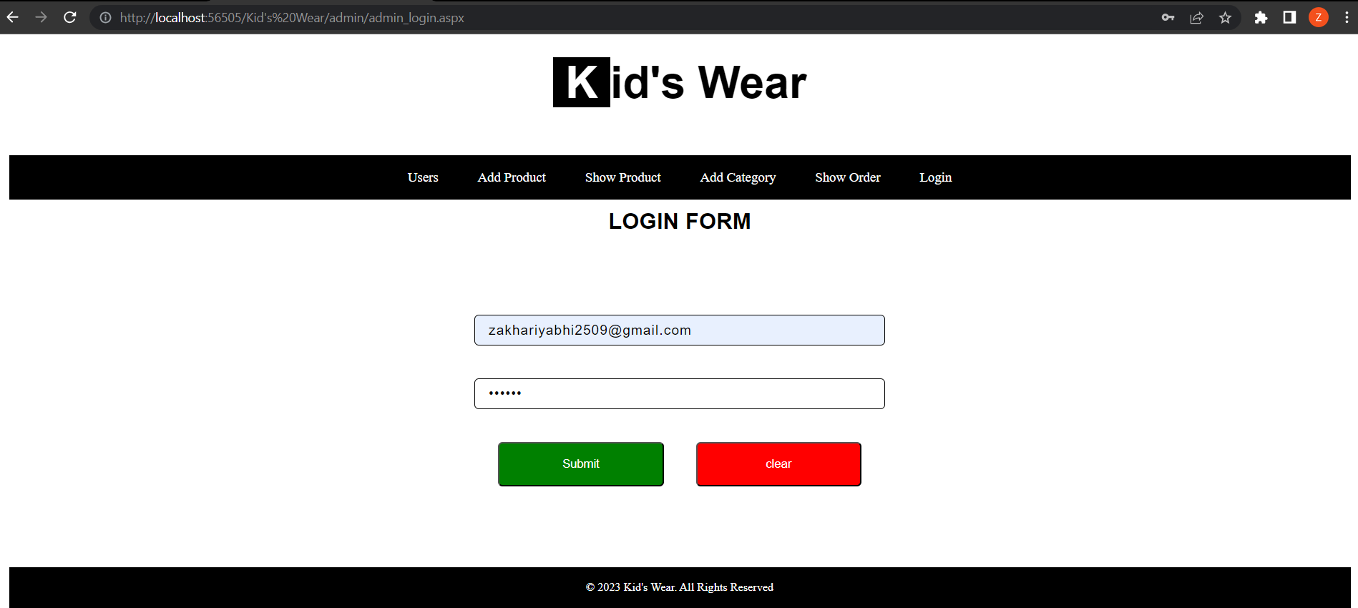

Slide 38
SHOW USERS

Slide 39
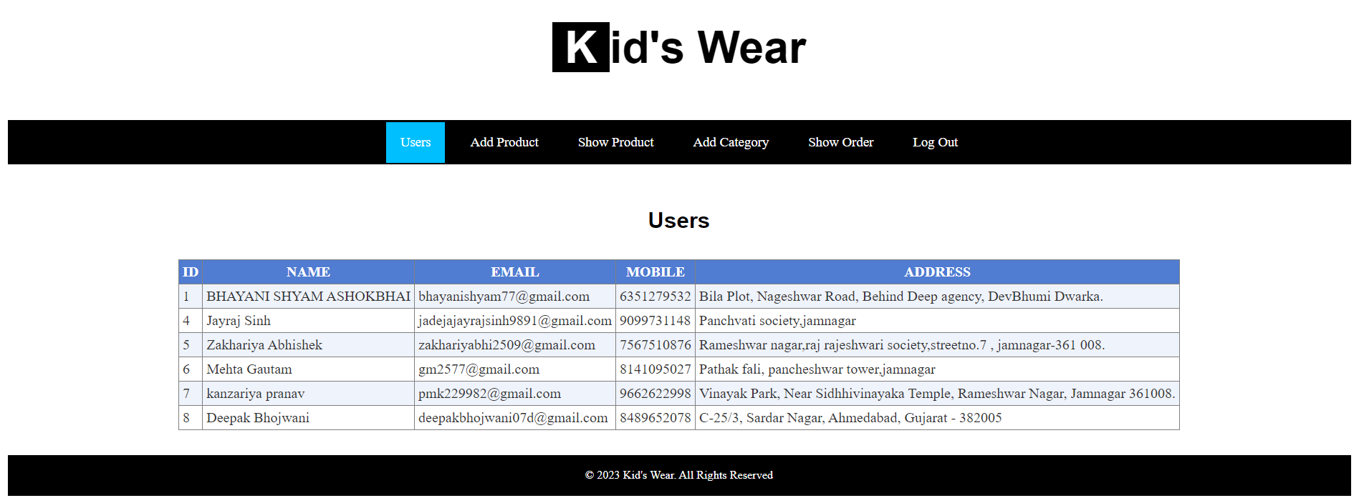

Slide 40
ADD PRODUCT

Slide 41
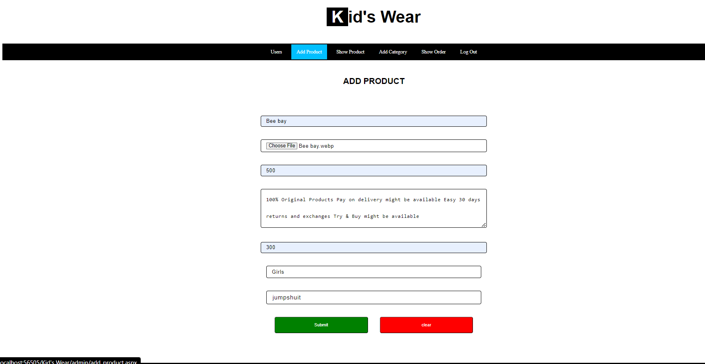

Slide 42
SHOW PRODUCT

Slide 43
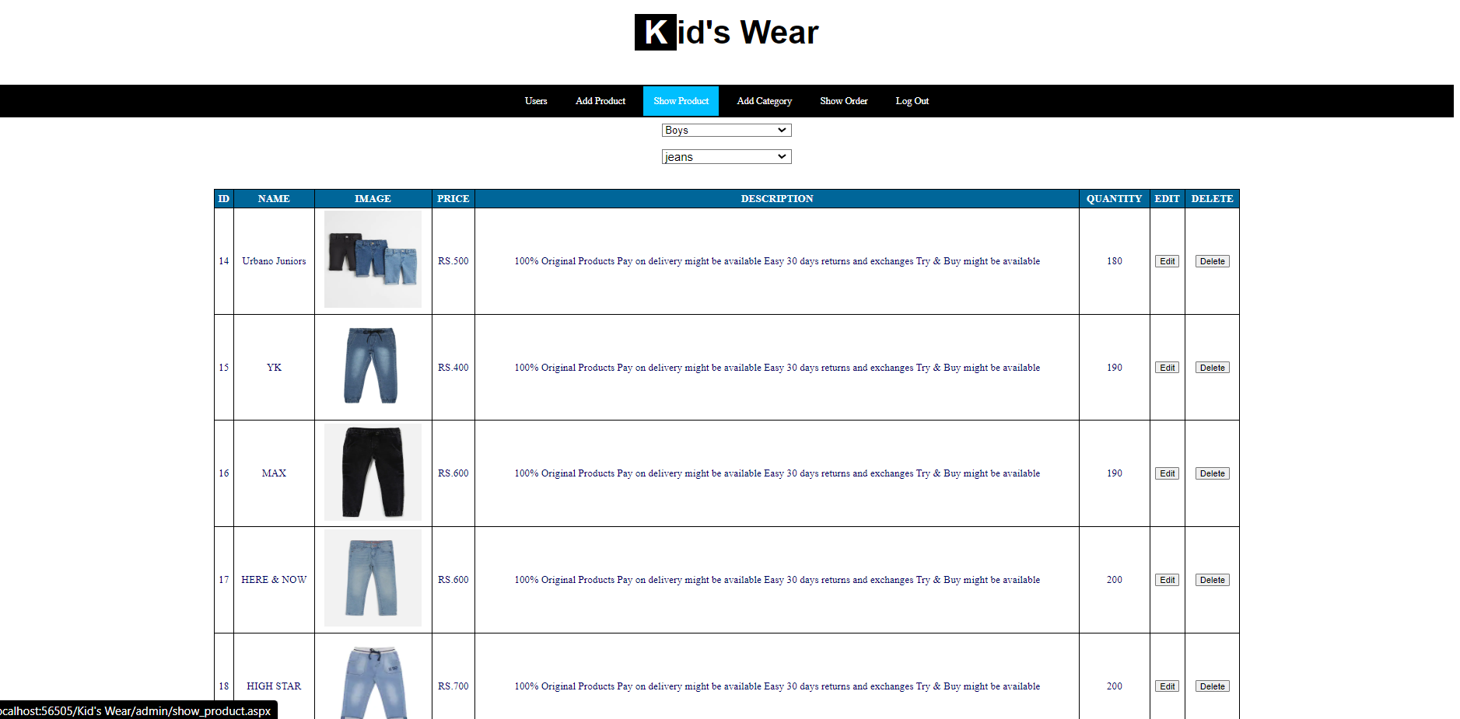

Slide 44
ADD CATEGORY

Slide 45
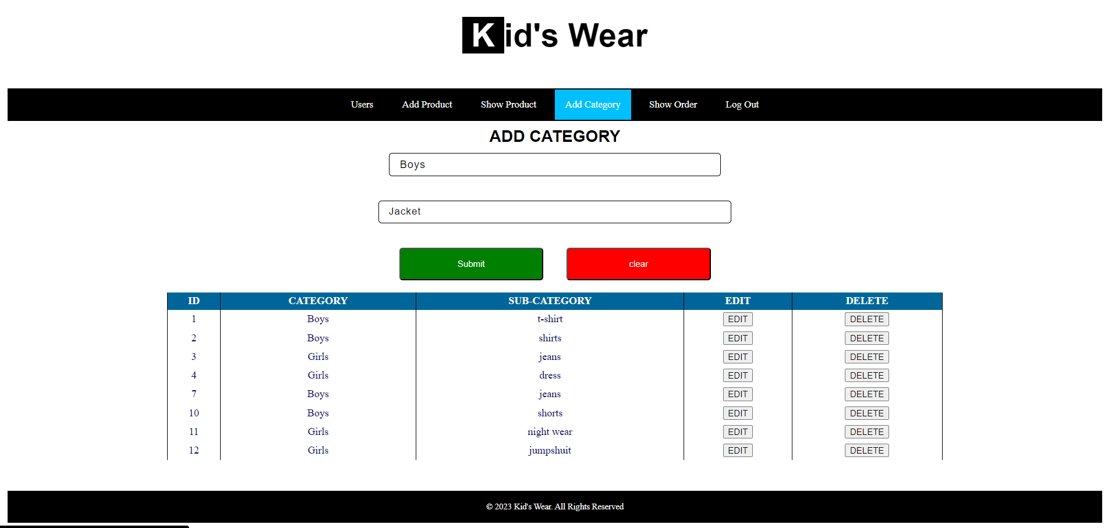

Slide 46
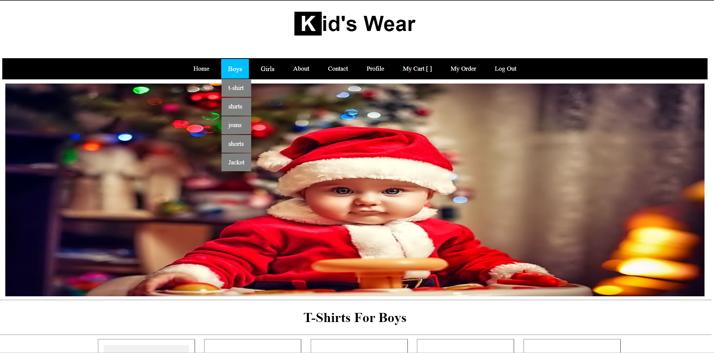

Slide 47
SHOW ORDERS

Slide 48
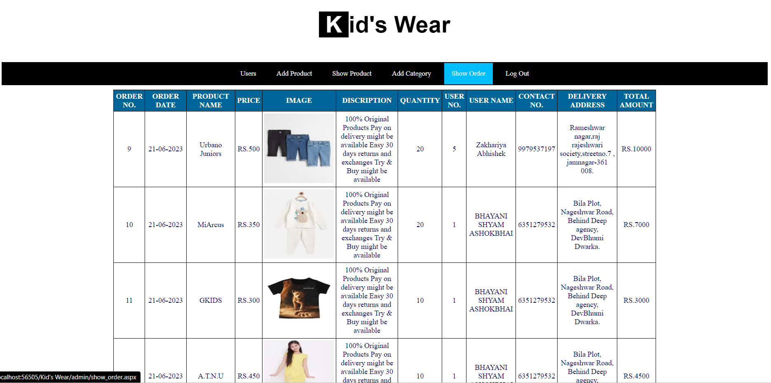

Slide 49
BIBLIOGRAPHY
Internet Help:-
www.stackoverflow.com
www.youtube.com

Slide 50
Thank You

